Slide 1
Demand, Supply and Market equilibrium
FIRMS AND HOUSEHOLDS:THE BASIC DECISION-MAKING UNITS
1) firm
An organization that transforms resources (inputs) into products (outputs).
Firms are the primary producing units in a market economy.
(Industry- combination of firm ; eg car – industry , Maruti – firm)
2) entrepreneur
A person who organizes, manages, and assumes the risks of a firm,
taking a new idea or a new product and turning it into a successful business.
3) households
The consuming units in an economy. ( avg household size in india is 4.5 )
INPUT MARKETS AND OUTPUT MARKETS:THE CIRCULAR FLOW
4) product or output markets
The markets in which goods and services are exchanged.
5) input or factor markets
The markets in which the resources used to produce products are exchanged.
(eg-land,labour,,capital)
6) labor market
The input/factor market in which households supply work for wages to firms that demand labor.
7) capital market
The input/factor market in which households supply their savings, for interest or for claims to future profits, to firms that demand funds to buy capital goods.

Slide 2
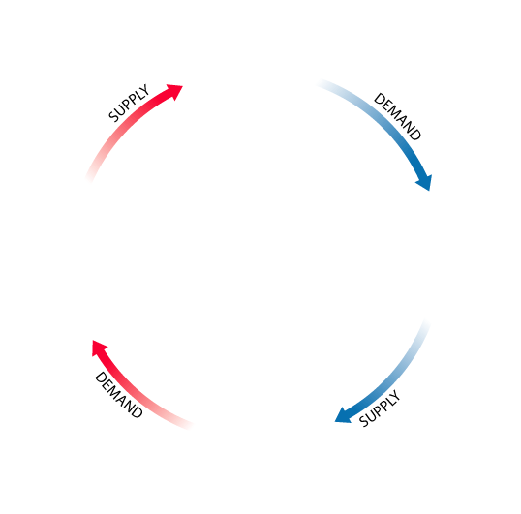
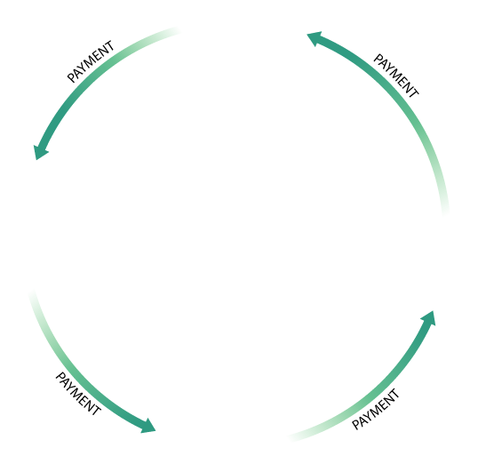
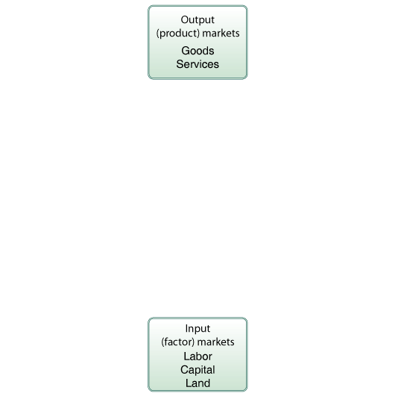
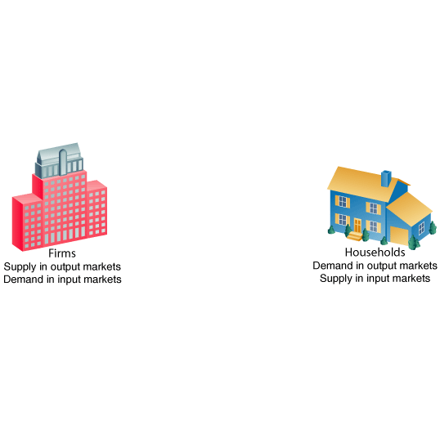
INPUT MARKETS AND OUTPUT MARKETS:THE CIRCULAR FLOW
8) land market
The input/factor market in which households supply land or other real property in exchange for rent.
The Circular Flow of Economic Activity
9) factors of production
The inputs into the production process. Land, labor, and capital are the three key factors of production. ( 4th one is enterprenurship )
Input and output markets are connected through the behavior of both firms and households.
Firms determine the quantities and character of outputs produced and the types of quantities of inputs demanded.
Households determine the types and quantities of products demanded and the quantities and types of inputs supplied.

Slide 3
(1) DEMAND IN PRODUCT/OUTPUT MARKETS
A household’s decision about what quantity of a particular output, or product, to demand depends on a number of factors including:
■ The price of the product in question
■ The income available to the household
■ The household’s amount of accumulated wealth
■ The prices of other products available to the household
■ The household’s tastes and preferences
■ The household’s expectations about future income, wealth, and prices
■ age , gender , distribution of income
Real demand – 1. u need it 2. u ve capability to buy 3. u ve plan to buy it
10) quantity demanded
The amount (number of units) of a product that a household would buy in a given period if it could buy all it wanted at the current market price.
CHANGES IN QUANTITY DEMANDED VERSUS CHANGES IN DEMAND
The most important relationship in individual markets is that between market price and quantity demanded.
Changes in the price of a product affect the quantity demanded per period.
Changes in any other factor, such as income or preferences, affect demand.
Thus, we say that an increase in the price of Coca-Cola is likely to cause a decrease in the quantity of Coca-Cola demanded.
However, we say that an increase in income is likely to cause an increase in the demand for most goods.

Slide 4
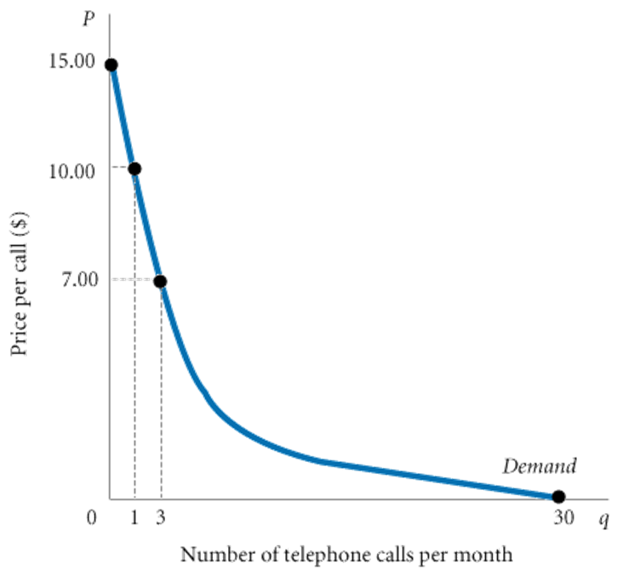
PRICE AND QUANTITY DEMANDED: THE LAW OF DEMAND
11) demand schedule
A table showing how much of a given product a household would be willing to buy at different prices.
TABLE 1 Anna’s Demand Schedule for Telephone Calls
PRICE (PER CALL) | QUANTITY DEMANDED (CALLS PER MONTH)
$ 0 | 30
.50 | 25
3.50 | 7
7.00 | 3
10.00 | 1
15.00 | 0
12) demand curve
A graph illustrating how much of a given product a household would be willing to buy at different prices.
Demand Curves Slope Downward
13) law of demand
The negative relationship between price and quantity demanded: As price rises, quantity demanded decreases. As price falls, quantity demanded increases.
FIGURE 2Anna’s
Demand Curve
They have a negative slope. An increase in price is likely to lead to a decrease in quantity demanded, and a decrease in price is likely to lead to an increase in quantity demanded.
It is reasonable to expect quantity demanded to fall when price rises, ceteris paribus,( meaning- other things remmaning constant )
and to expect quantity demanded to rise when price falls,
ceteris paribus.
Demand curves have a negative slope.

Slide 5
OTHER DETERMINANTS OF HOUSEHOLD DEMAND
14) income
The sum of all a household’s wages, salaries, profits, interest payments, rents, and other forms of earnings in a given period of time. It is a flow measure.
15) wealth or net worth
The total value of what a household owns minus what it owes.
It is a stock measure.
16) normal goods
Goods for which demand goes up when income is higher and for which demand goes down when income is lower.
17) inferior goods
Goods for which demand tends to fall when income rises. ( eg- oil – ruchi oil)
18) substitutes
Goods that can serve as replacements for one another:
when the price of one increases, demand for the other goes up.
19) perfect substitutes
Identical products.
Perfect substitutes? On a hot day in the desert, one brand is as good as another.
20) complements, complementary goods
Goods that “go together”:
a decrease in the price of one results in an increase in demand for the other, and vice versa. (e.g. Car and Petrol , tea and sugar ,ink and pen )
Expectations (if I expect price to increase , ill buy stock )
Tastes and Preferences

Slide 6
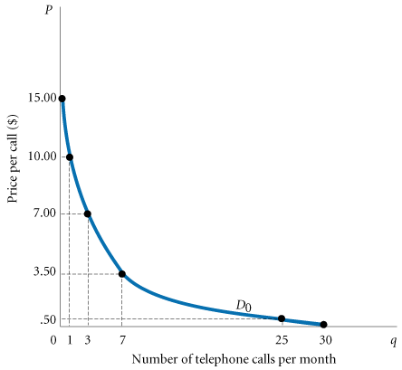
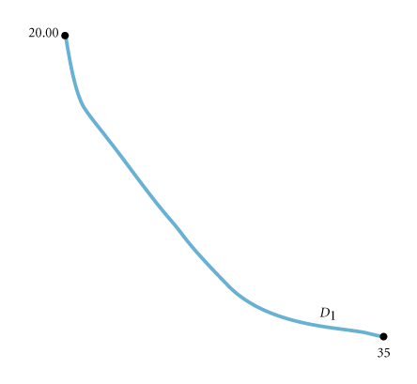
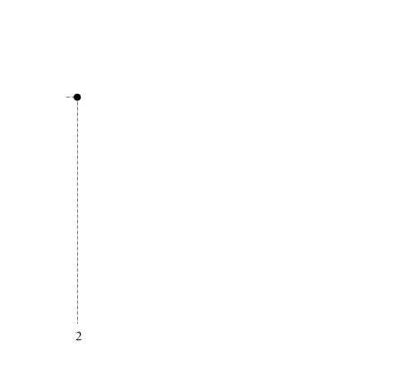
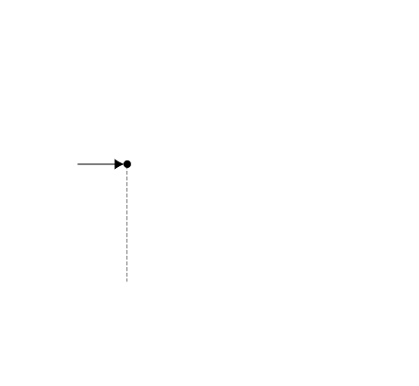
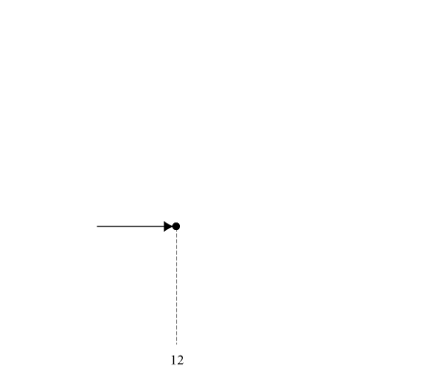
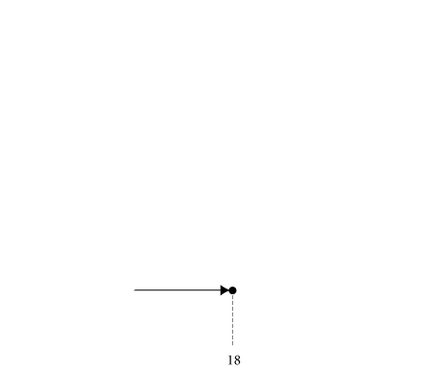
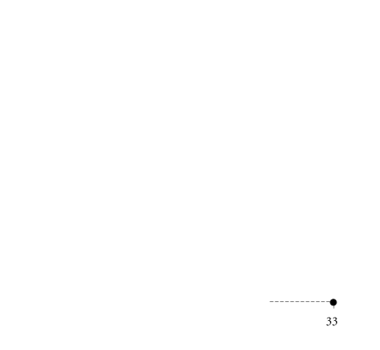
SHIFT OF DEMAND VERSUS MOVEMENT ALONG A DEMAND CURVE
TABLE 3. Shift of Anna’s Demand Schedule Due to increase in Income
 | SCHEDULE D₀ | SCHEDULE D₁
Price (Per Call) | Quantity Demanded (Calls Per Month at an Income of $300 Per Month) | Quantity Demanded (Calls Per Month at an Income of $600 Per Month)
$ 0 | 30 | 35
.50 | 25 | 33
3.50 | 7 | 18
7.00 | 3 | 12
10.00 | 1 | 7
15.00 | 0 | 2
20.00 | 0 | 0
FIGURE 3Shift of a Demand Curve Following a Rise in Income
NORMAL GOOD – INCOME-DEMAND
21) shift of a demand curve
The change that takes place in a demand curve corresponding to a new relationship between quantity demanded of a good and price of that good.
The shift is brought about by a change in the original conditions.( EG- income change)
22) movement along a demand curve
The change in quantity demanded brought about by a change in price.
23) market demand
The sum of all the quantities of a good or service demanded per period by all the households buying in the market for that good or service.

Slide 7
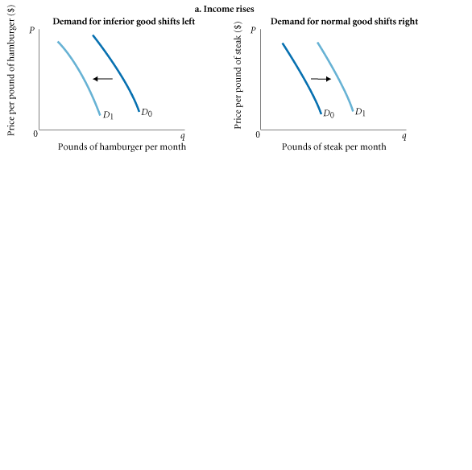
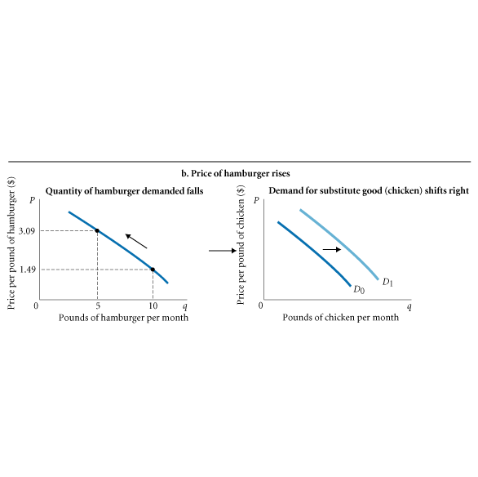
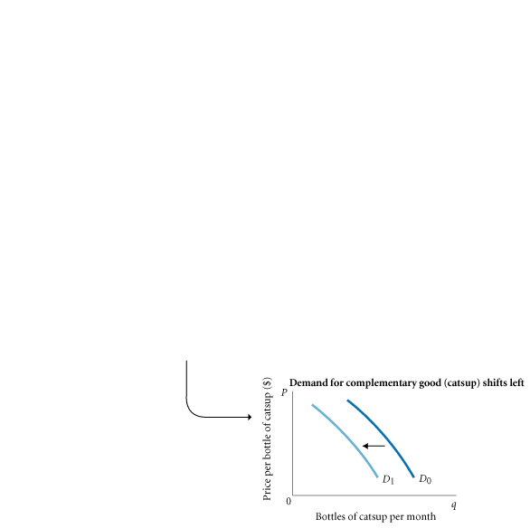
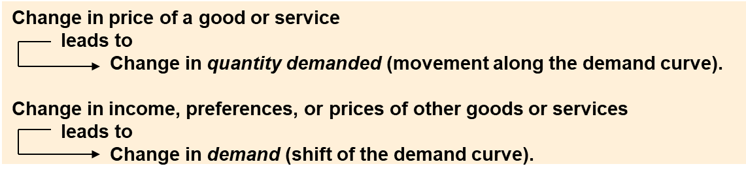
FIGURE 4 Shifts versus Movement along a Demand Curve

Slide 8
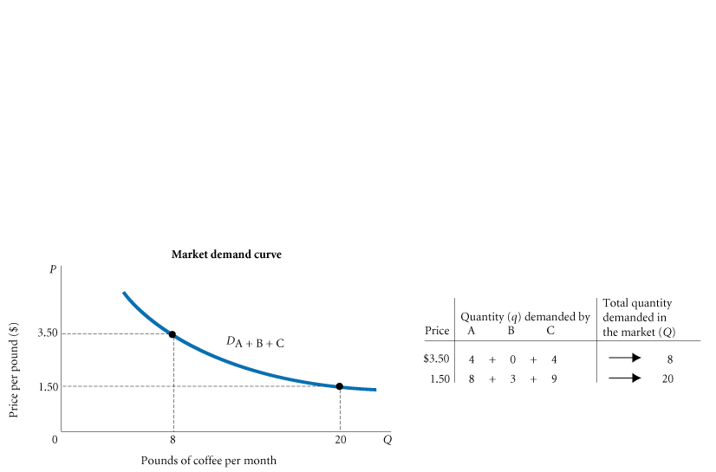
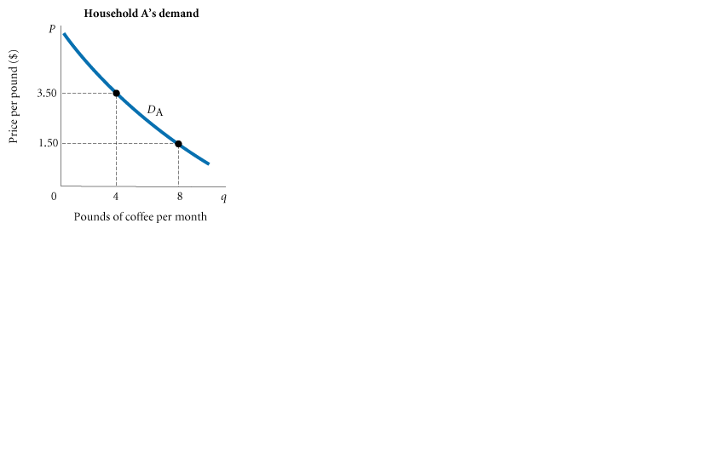
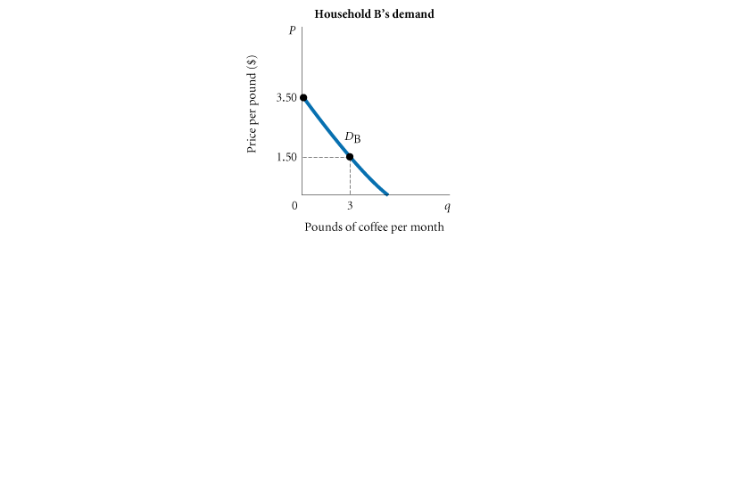
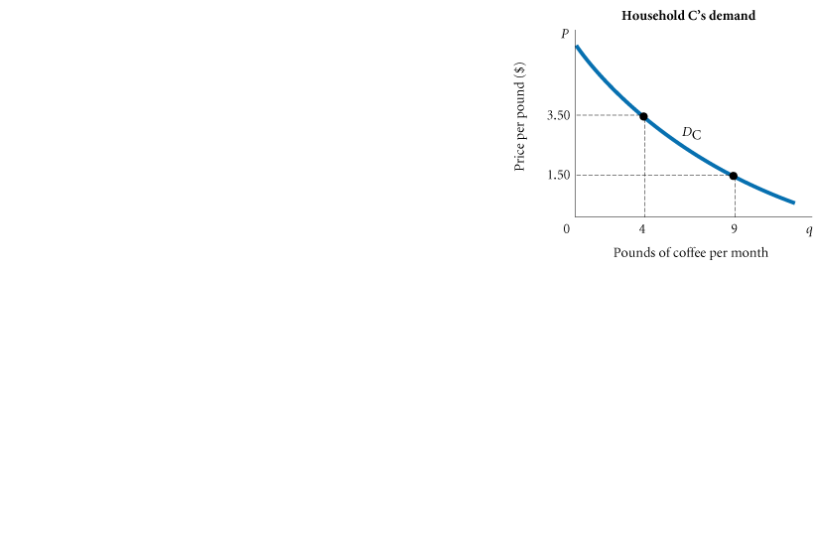
FIGURE 5 Deriving Market Demand from Individual Demand Curves
Market demand-addition of indivisual demands

Slide 9
(2) SUPPLY IN PRODUCT/OUTPUT MARKETS
Successful firms make profits because they are able to sell their products for more than it costs to produce them.
24) profit ( revenue-cost)
The difference between revenues and costs.
25) quantity supplied ( if price inc , qnty inc)
The amount of a particular product that a firm would be willing and able to offer for sale at a particular price during a given time period.
26) law of supply
The positive relationship between price and quantity of a good supplied: An increase in market price will lead to an increase in quantity supplied, and a decrease in market price will lead to a decrease in quantity supplied.
28) OTHER DETERMINANTS OF SUPPLY
a) The Cost of Production
Regardless of the price that a firm can command for its product, revenue must exceed the cost of producing the output for the firm to make a profit.
b) The Prices of Related Products
A soybean farm is a producer
that supplies soybeans to the
market.

Slide 10
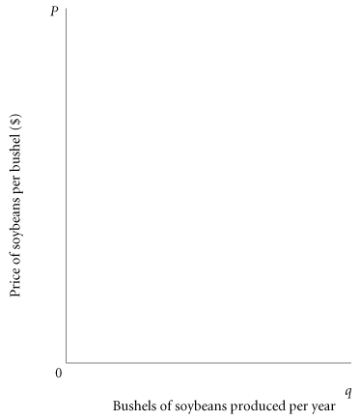
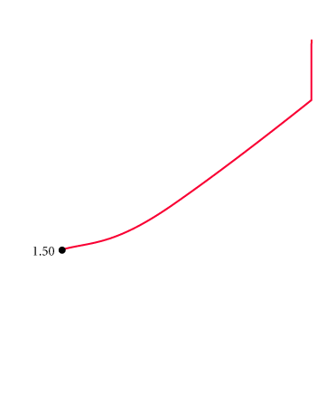
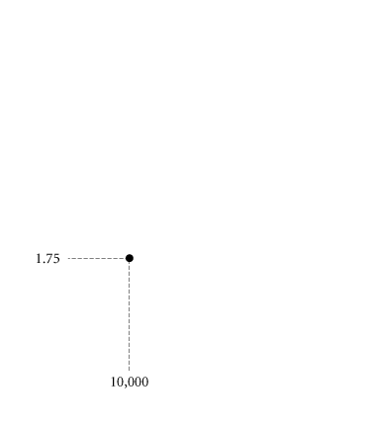
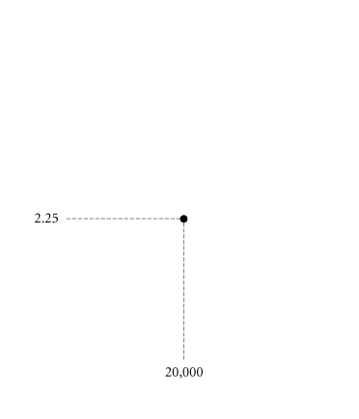
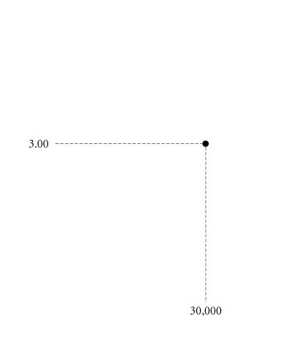
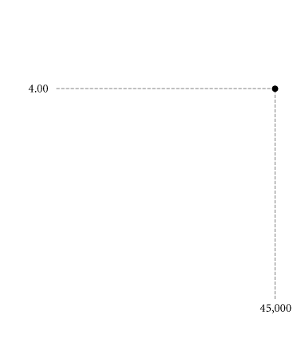

28) supply schedule
A table showing how much of a product firms will sell at different prices.
29) supply curve
A graph illustrating how much of a product a firm will sell at different prices.
TABLE 3.3 Clarence Brown’s Supply Schedule for Soybeans
PRICE (PER BUSHEL) | QUANTITY SUPPLIED (BUSHELS PER MONTH)
$1.50 | 0
1.75 | 10,000
2.25 | 20,000
3.00 | 30,000
4.00 | 45,000
5.00 | 45,000
Optimum supply
Assuming that its objective is to maximize profits, a firm’s decision about what quantity of output, or product, to supply depends on
1. The price of the good or service
2. The cost of producing the product, which in turn depends on
■The price of required inputs (labor-wage, capital-intrest, and land-rate)
■The technologies that can be used to produce the product
3. The prices of related products
FIGURE 6 Clarence Brown’s Individual Supply Curve

Slide 11
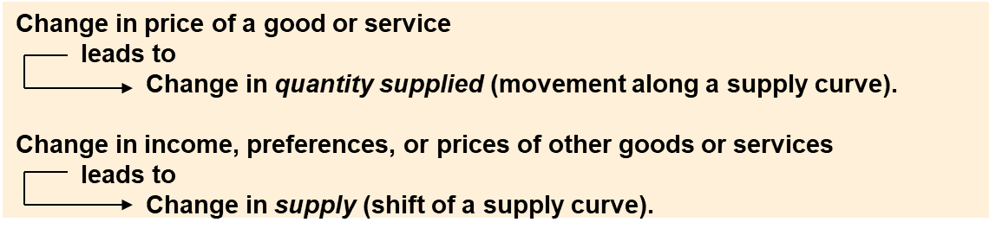
SHIFT OF SUPPLY VERSUS MOVEMENT ALONG A SUPPLY CURVE
30) movement along a supply curve
The change in quantity supplied brought about by a change in price.
31) shift of a supply curve
The change that takes place in a supply curve corresponding to a new relationship between quantity supplied of a good and the price of that good. The shift is brought about by a change in the original conditions.
As with demand, it is very important to distinguish between movements along supply
curves (changes in quantity supplied) and shifts in supply curves (changes in supply):
32) market supply
The sum of all that is supplied each period by all producers of a single product.

Slide 12
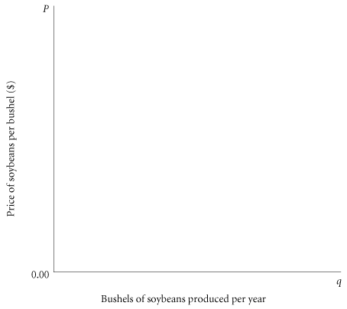
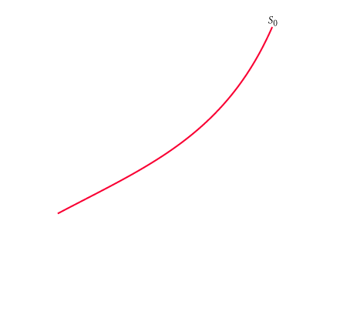
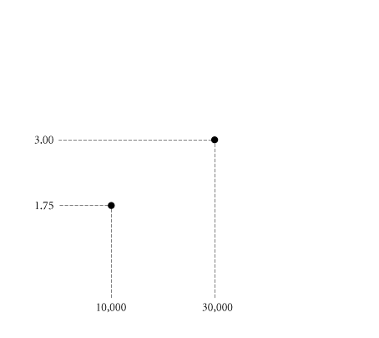
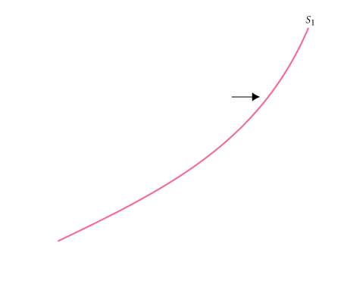
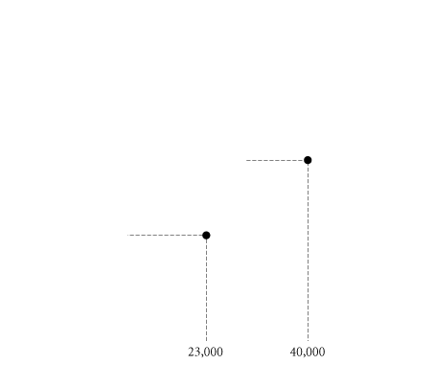
SUPPLY IN PRODUCT/OUTPUT MARKETS
TABLE 3 Shift of Supply Schedule for Soybeans Following Development of a New Disease-Resistant Seed Strain
 | SCHEDULE D₀ | SCHEDULE D₁
Price (Per Bushel) | Quantity Supplied (Bushels Per Year Using Old Seed) | Quantity Supplied (Bushels Per Year Using New Seed)
$1.50 | 0 | 5,000
1.75 | 10,000 | 23,000
2.25 | 20,000 | 33,000
3.00 | 30,000 | 40,000
4.00 | 45,000 | 54,000
5.00 | 45,000 | 54,000
FIGURE 3 Shift of Supply Curve for Soybeans Following Development of a
New Seed Strain

Slide 13
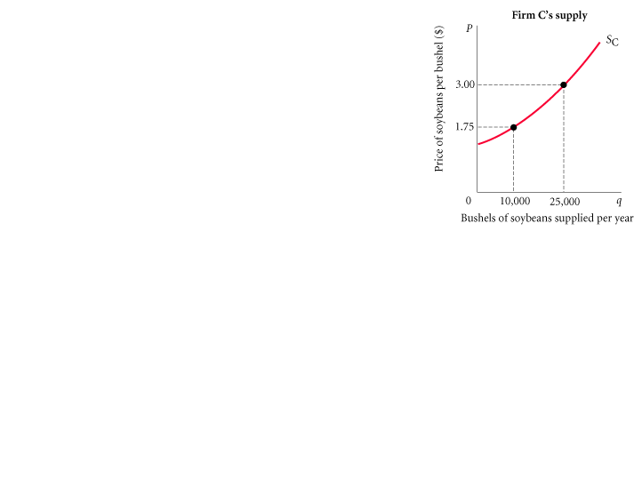
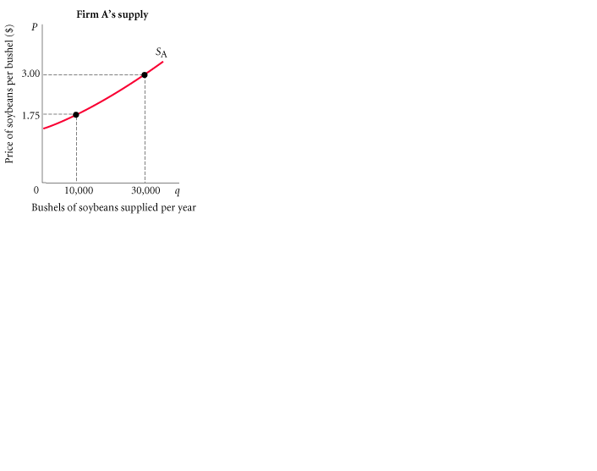
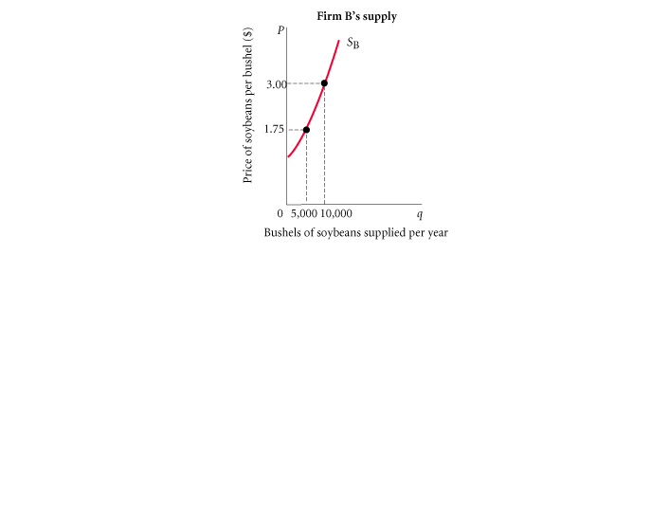
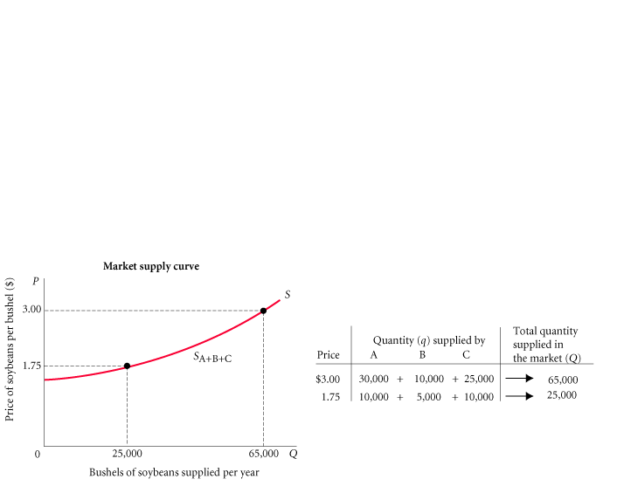
SUPPLY IN PRODUCT/OUTPUT MARKETS
FIGURE 8 Deriving Market Supply from Individual Firm Supply Curves

Slide 14
(3) MARKET EQUILIBRIUM
33) equilibrium
The condition that exists when quantity supplied and quantity demanded are equal. At equilibrium, there is no tendency for price to change.
34) excess demand or shortage
The condition that exists when quantity demanded exceeds quantity supplied at the current price.
Bidding at an auction starts with excess demand and ends up with quantity demanded and quantity supplied equal.
35) excess supply or surplus
The condition that exists when quantity supplied exceeds quantity demanded at the current price.

Slide 15
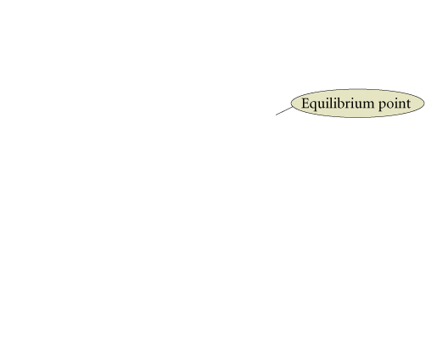
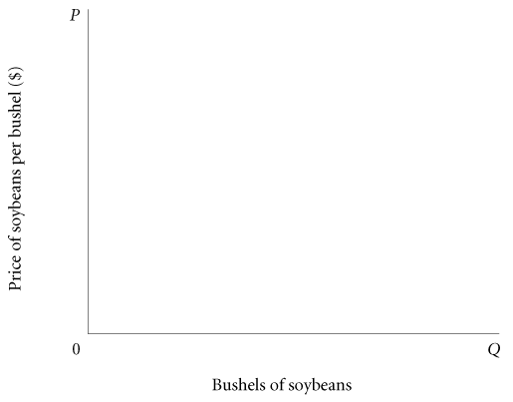
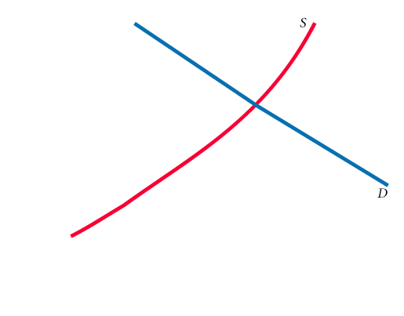
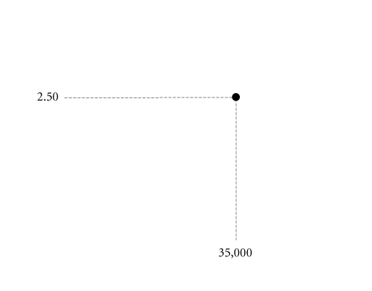
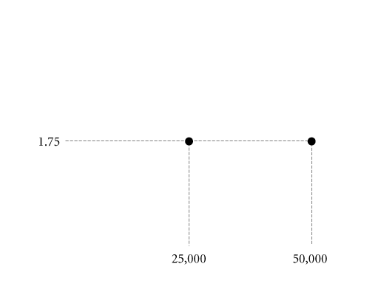
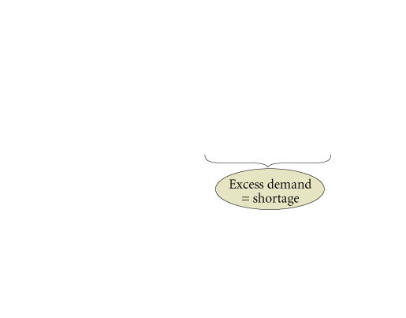
FIGURE 9 Excess Demand, or Shortage
When quantity demanded exceeds quantity supplied, price tends to rise.
When the price in a market rises, quantity demanded falls and quantity supplied rises until an equilibrium is reached at which quantity demanded and quantity supplied are equal.

Slide 16
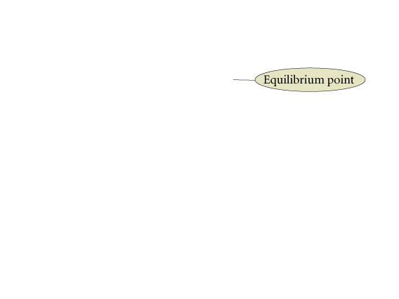
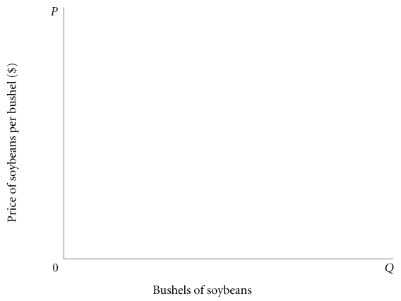
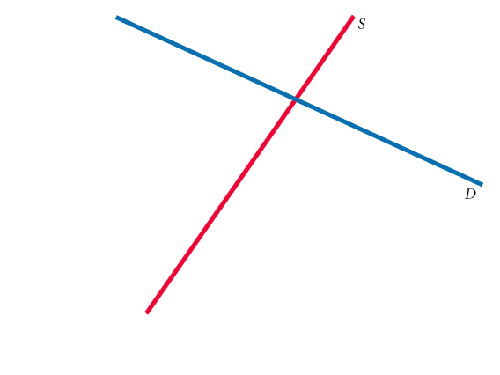
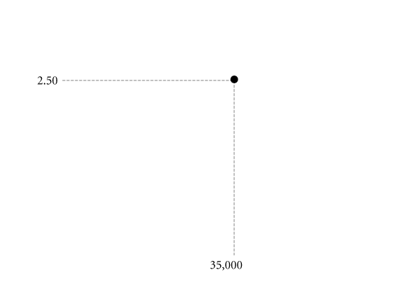
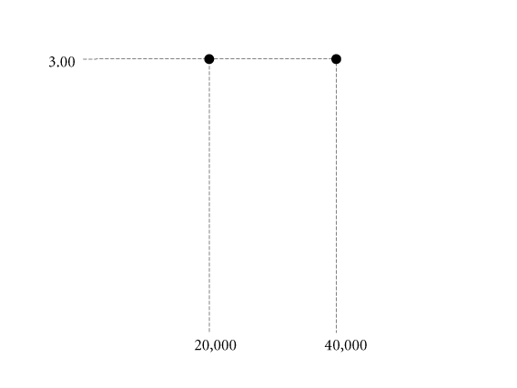
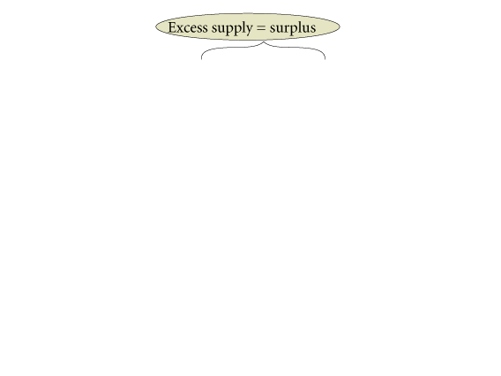
FIGURE 10 Excess Supply, or Surplus
When quantity supplied exceeds quantity demanded at the current price, the price tends to fall.
When price falls, quantity supplied is likely to decrease and quantity demanded is likely to increase until an equilibrium price is reached where quantity supplied and quantity demanded are equal.

Slide 17
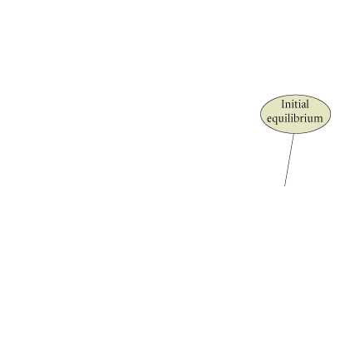
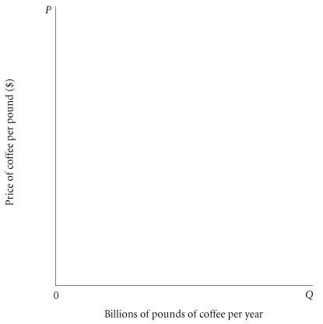





CHANGES IN EQUILIBRIUM
When supply and demand curves shift,
the equilibrium price and quantity change.
FIGURE 11 The Coffee Market: A Shift of Supply and Subsequent Price Adjustment

Slide 18

FIGURE 12 Examples of Supply and Demand Shifts for Product X

Slide 19
DEMAND AND SUPPLY IN PRODUCT MARKETS: A REVIEW
Here are some important points to remember about the mechanics of supply and demand in product markets:
1. A demand curve shows how much of a product a household would buy if it could buy all it wanted at the given price. A supply curve shows how much of a product a firm would supply if it could sell all it wanted at the given price.
2. Quantity demanded and quantity supplied are always per time period—that is, per day, per month, or per year.
3. The demand for a good is determined by price, household income and wealth, prices of other goods and services, tastes and preferences, and expectations.
4. The supply of a good is determined by price, costs of production, and prices of related products. Costs of production are determined by available technologies of production and input prices.
5. Be careful to distinguish between movements along supply and demand curves and shifts of these curves. When the price of a good changes, the quantity of that good demanded or supplied changes—that is, a movement occurs along the curve. When any other factor changes, the curve shifts, or changes position.
6. Market equilibrium exists only when quantity supplied equals quantity demanded at the current price.

Slide 20
REVIEW TERMS AND CONCEPTS
capital market
complements, complementary goods
demand curve
demand schedule
entrepreneur
equilibrium
excess demand or shortage
excess supply or surplus
factors of production
firm
households
income
inferior goods
input or factor markets
labor market
land market
law of demand
law of supply
market demand
market supply
movement along a demand curve
movement along a supply curve
normal goods
perfect substitutes
product or output markets
profit
quantity demanded
quantity supplied
shift of a demand curve
shift of a supply curve
substitutes
supply curve
supply schedule
wealth or net worth

